Slide 1

DESIGN AND SIMULATION OF CASCADED KINK BEAM ACTUATOR
PRESENTED BY MS. STHUTI A, VARUN RAVEENDRA, NEEMA NAIK, ROHAN K
Dept. of Electronics and Communication
Center for nanomaterials and MEMS
Nitte Meenakshi Institute of Technology
Notes:
good afternoon to all the teachers and panel members present here, i varun raveendra along with my team, sthuti maam , neema naik, and rohan k , from nitte meenakshi institute of technology are here to present on our updated results and analysis of the cascaded kink beam actuator.

Slide 2


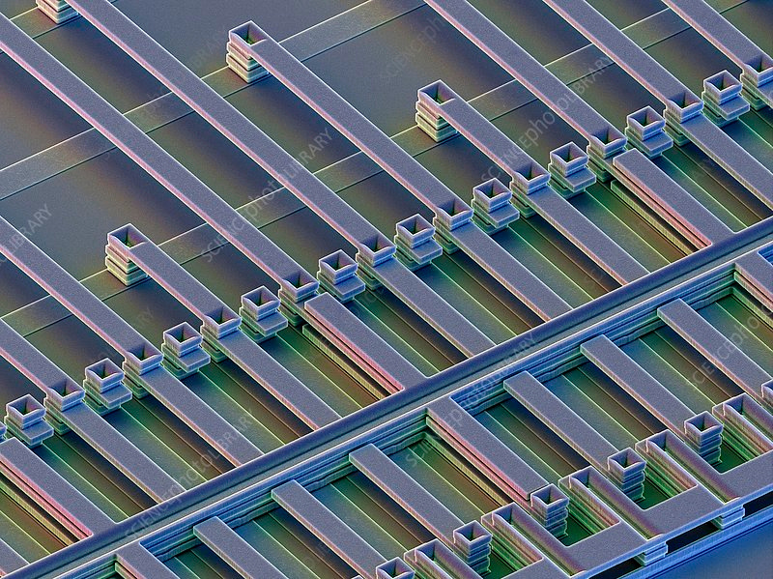
INTRODUCTION
Thermal actuators are mechanical systems that use thermally induced expansion and contraction of materials as a mechanism for the creation of motion. These devices are compliant structures, using elastic deformation and mechanical constraints, that frequently are designed to amplify the motion generated by thermal expansion or contraction. Temperature changes that result in thermal actuation are most commonly provided by environmental changes or by Joule heating from electrical current flow. In context of nanotechnology, thermal actuators refer to microscale and nanoscale devices used to mechanically interact with nanoscale structures, with motion generated by the thermally induced expansion and contraction of materials.
Notes:
introduction
thermal actuators are mechanical structures , that use the property of electrothermal expansion , and contraction as a mechanism to create motion. one of the main principles involved in thermal actuators is joule heating. electrothermal actuators are designed to amplify the expansion caused by heating..

Slide 3
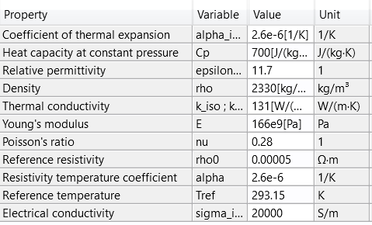
MATERIAL USED
Silicon (single-crystal) isotropic is the material used for fabrication of the MEMS thermal actuator, the material specifications are given below:
Notes:
the material used for our design is the silicon single crystal isotropic , and these are the properties of the material. the thermal conductivity , young's modulus , Poisson's ratio , resistivity, conductivity and temperature has been set as per specifications.

Slide 4
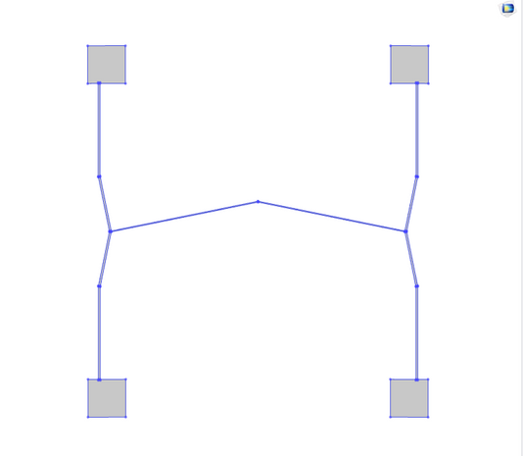
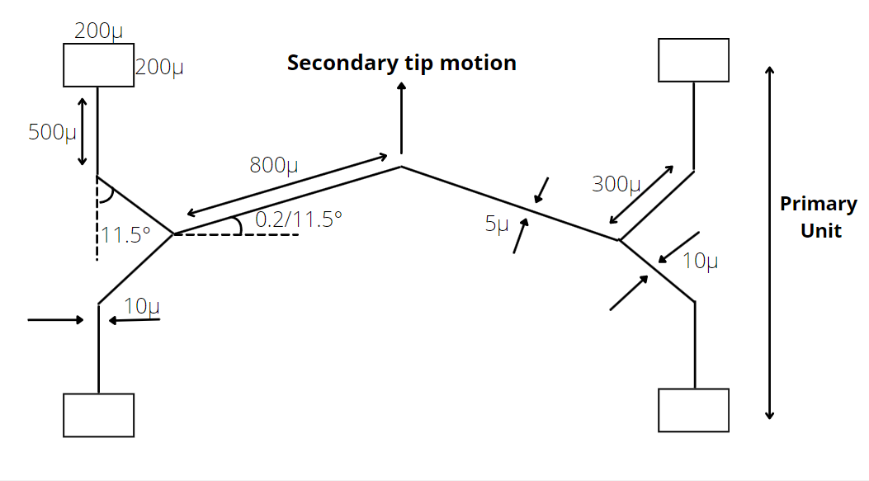
DESIGN OF CASCADED KINK BEAM ACTUATOR
Fig 5: Structure on comsol multiphysics
Fig 4: Dimensions of our model
Notes:
these are the dimensions of our structure , the angle between the horizontal and the secondary beam is 0.2 radians and has a thickness of 5 micrometer........
and 0.2 radians and a thickness of 10micrometer for the kinked primary beams
and a uniform depth of 30micrometer for the whole structure.

Slide 5
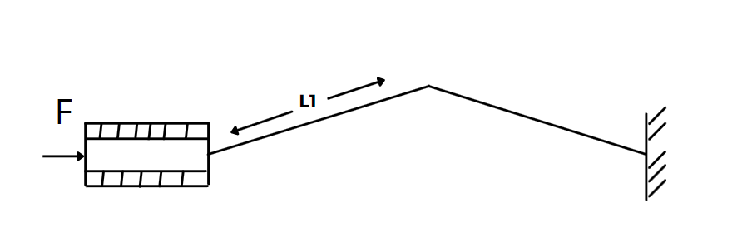
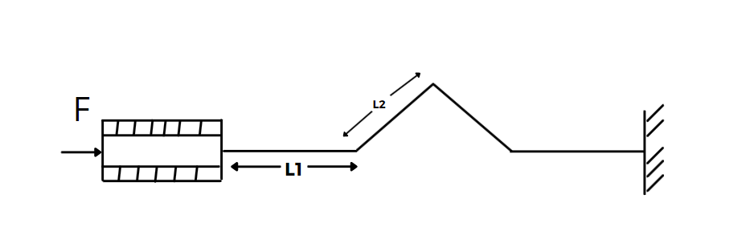
Design and Innovation
Traditional chevron shaped bent beam actuators (fig1) are one of the most commonly used actuators, the chevron's displacement increases with decreasing the angle with respect to horizontal.
The kink actuator (fig2) was selected as it has an improved amplification factor for a given input electrical potential, compared to an equivalent chevron actuator.
A kink is a structure that is formed when the end of the adjoined beams are moved slightly out of their aligned position.
fig1
fig2
Notes:
coming to design and innovation , as we know chevron shaped bent beam is most commonly used in thermal actuators, this structure has an increasing displacement as the angle wrt to the horizontal decreases.
However, our design adopts the use of the kink actuator, the kinked structure has an improved amplification factor for a given electric potential compared to an equivalent chevron actuator.so
kink is a structure that is formed when the end of the beams are slightly out of their aligned position.
figure 1 and figure 2 shows us the difference of the two types of actuators.

Slide 6
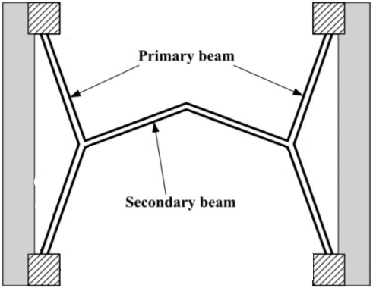
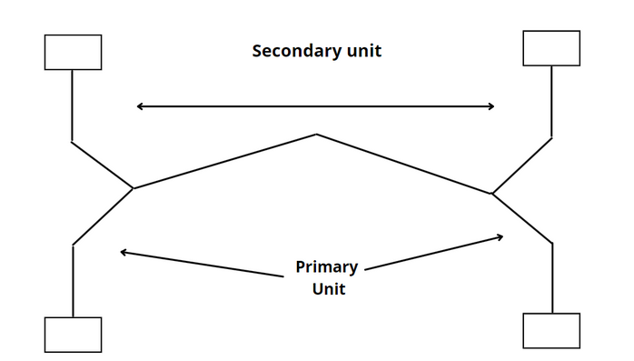
Design and Innovation
Cascaded thermal actuators are used to further amplify the displacement, when current is confined to two primary units, the secondary unit serves as a motion amplifier.
Cascaded devices have a significantly larger displacement than simple beams even when the secondary beam is not heated.
Also observed is another phenomenon, 'buckling' due to which the amplification factor begins to decrease. The actuators start to buckle out-of-plane instead of in-plane.
The amplification factor for the kink beam was seen to be higher than the chevron actuators at all offsets.
Our model prevents the occurrence of buckling-caused by the force applied on the structure, making the overall structure unstable. Kink beams prevent the occurrence of buckling in beams.
Notes:
cascaded thermal actuators are used to further amplify the displacement, from the primary beams, making the secondary beam work as a motion amplifier.
we have adopted the kink actuator as primary beams for our structure of the cascaded kink actuator. also another advantage of this model is that it prevents the occurrence of buckling at the primary beams, and keeps the amplification factor of the beam higher than that of chevron actuator.

Slide 7
THEORETICAL EQUATIONS
The heat generated per unit volume per unit time due to joule heating is given by:
H= i²Rt
i is current and R is the resistance, which varies due to temperature.
The maximum displacement of an electrothermal actuator is given by:
Dmax = 2𝑡𝑎𝑛 𝜃1/𝐾 ∗ tan ( 𝐾𝐿1/4 ) − 𝐿1 tan (𝜃1)/2
𝜃1 is the angle made with respect to horizontal and L1 is the length between the two end points of the beam and K is the unknown eigen value:
K=√(𝐹 /𝐸 𝐼 )
F is the reaction force, E is young's modulus and 𝐼 is the moment of inertia of the beams.
I is defined as:
I= (bd³)/ 12
Notes:
theoretical equations
the first equation is given as the heat generated due to joule heating.
the next equation gives the formula of the chevron type beam as we observe the secondary beam is of chevron type, so this gives us the formula for maximum displacement.
K gives the unknown eigen value and i gives the moment of inertia.

Slide 8
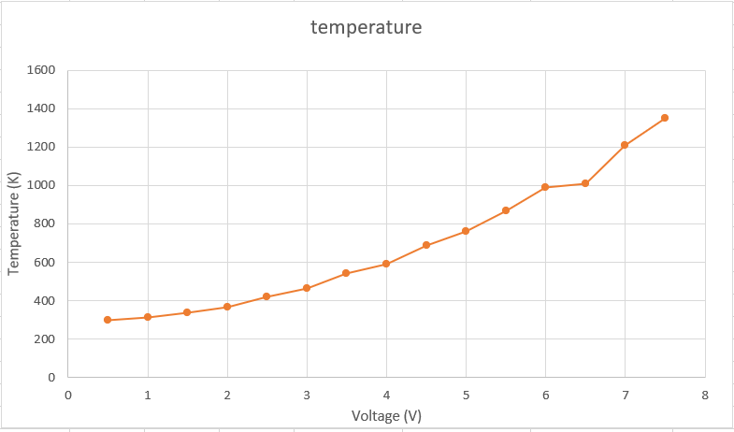
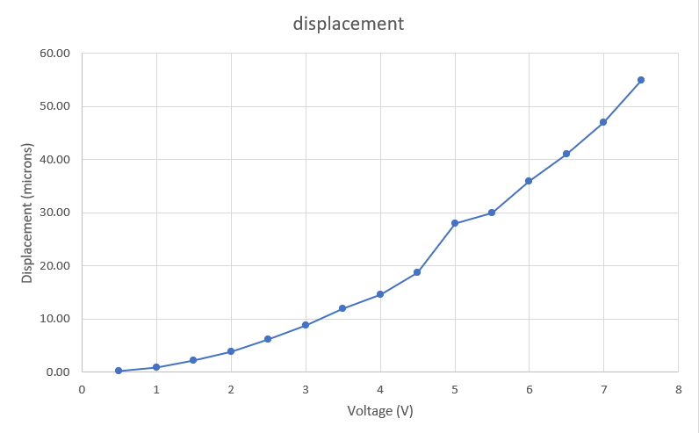
RESULTS AND ANALYSIS
Notes:
these graphs explain the effect of varying the voltage supply, the first graph shows voltage versus temperature , as we can see here a voltage between 0.5 to 7.5 has a temperature that can be observed as linearly increasing , and under the melting point of silicon.
the second graph shows the displacement observed for voltage supply of 0.5 to 7.5 , and we observe that for a voltage greater than 1.5volts , the displacement is greater than 2 microns, and increases linearly.

Slide 9
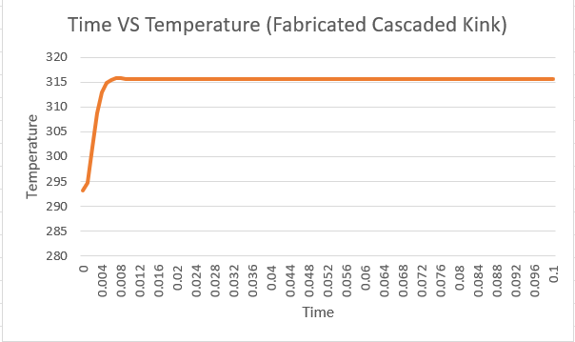
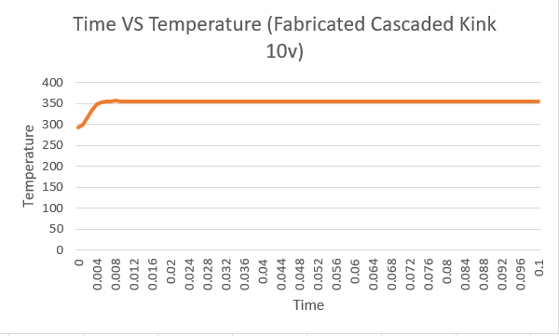

Slide 10
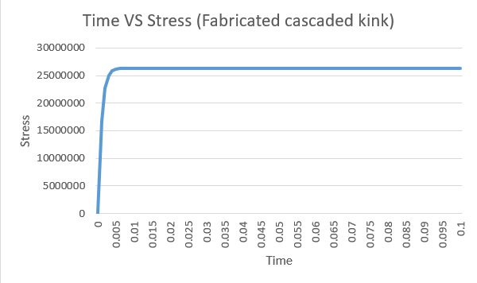
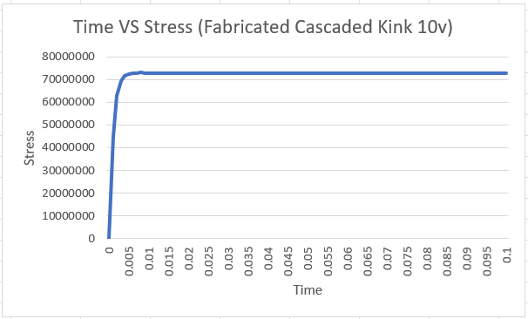

Slide 11
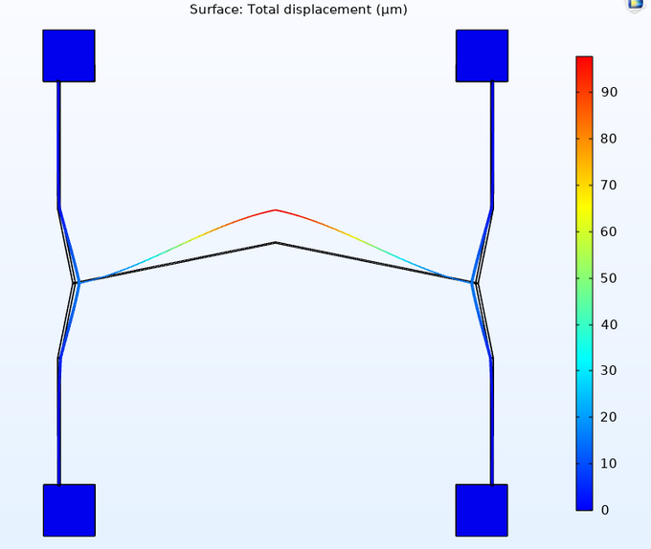
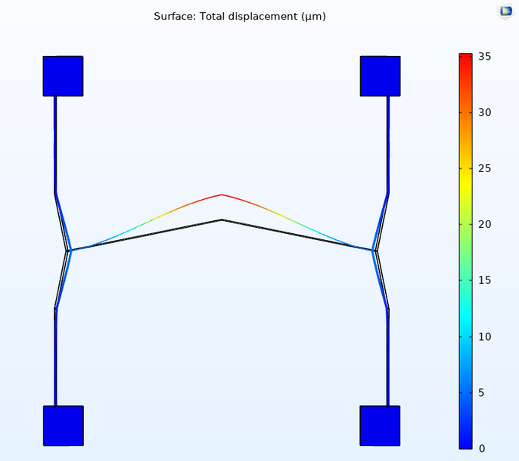
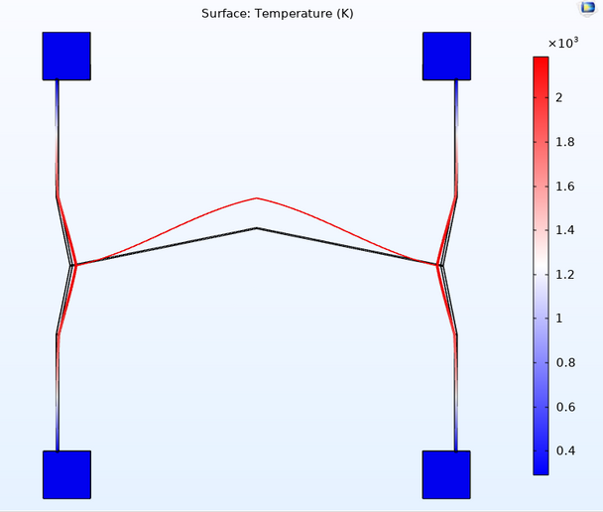
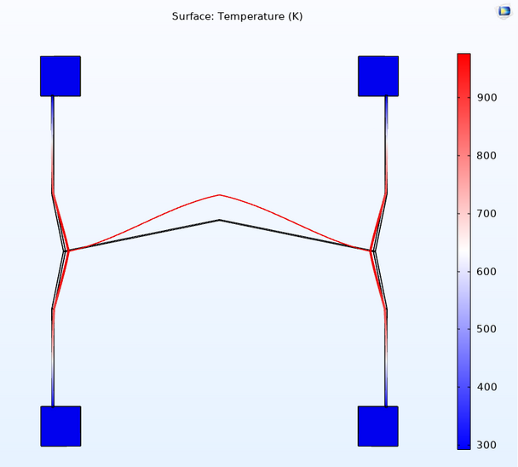

RESULTS AND ANALYSIS
From our results we were able to achieve a displacement of up to 95μm for a voltage of 10V.
But since Silicon has a melting point of 1600 K. We had to restrict our electric potential to a voltage of 8.5V.
The structure has varying cross-section which results in non-uniform pattern of heating, to prevent this unpredictable changes in temperature, the structure must be restricted under 8.5V.
The model works well between the voltage of 1.5V to 8.5V, achieving a displacement greater than 2μm.
Results for 10 V
Results for 6V
Notes:
we were able to achieve a displacement of up to 95 microns for a voltage of 10 volts.
but we observed that the temperature of the beam is crossing the melting point of silicon which is around 1600 kelvin. due to this we had to limit our voltage supply. and restricted it at 8.5volts , which keeps the temperature well under 1600 kelvin.
the structure works efficiently between 1.5v to 8.5v , by having the displacement greater than 2microns.

Slide 12
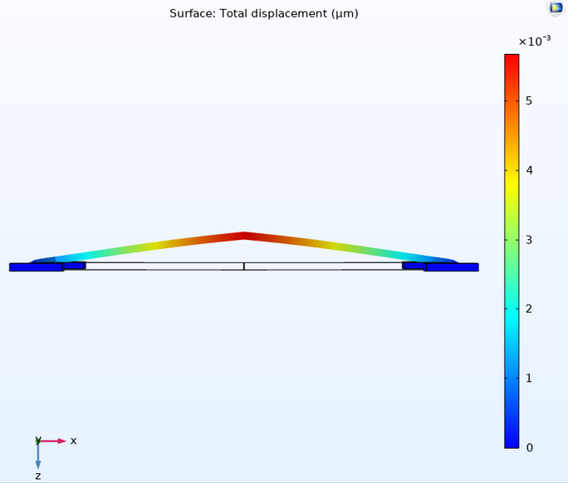
RESULTS AND ANALYSIS
The results shown are for a voltage of 6V, where we were able to achieve a displacement of up to 35μ keeping the temperature in check.
The structure consists of beams of different cross-sections, as the secondary beam is very thin, we had to carryout the simulation keeping in mind the effect of gravity on our model, the effect of gravity on the structure has a negligible out-of-plane deflection of about 5.8nm at the secondary beam.
This out-of-plane deflection has no effects on the performance of the model.
Notes:
Results and analysis
the results shown here are for an electric potential 6v , which has a displacement of 35microns.
Since our secondary beam is very thin , we had to carry out the simulation with the effect of gravity on the structure , which was found to be about 5.8 in the nanometer scale , which is negligible when we compare it to displacement.
this out-of-plane deflection has no effect on the performance of the model.

Slide 13
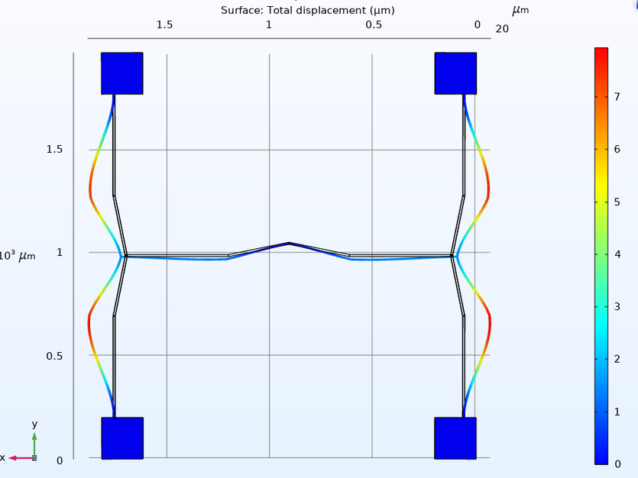
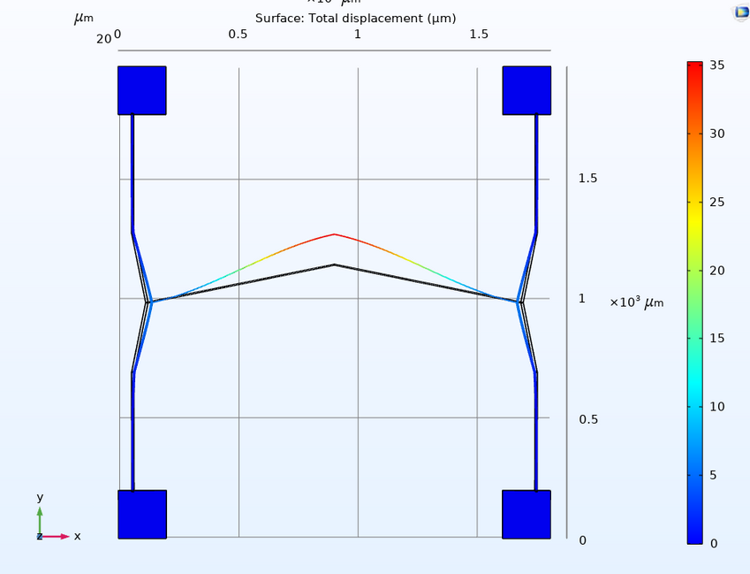
FULLY CASCADED KINK ACTUATOR VS CASCADED KINK ACTUATOR
Simulating the fully cascaded kink beam resulted in the failure of the system due to excessive buckling of the beams. Therefor using a compliant structure for the secondary unit that acts as an amplifier is found to be having better results.

Slide 14

COMPARATIVE STUDY OF THE CASCADED CHEVRON AND THE CASCADED KINK ACTUATOR (HOW OUR STRUCTURE IS BETTER?)
The following results and simulation shows the benefit of using the cascaded kink actuator over the cascaded chevron actuator, this comparative analysis is done mainly considering three factors,
Displacement •
Temperature •
Stress

Slide 15
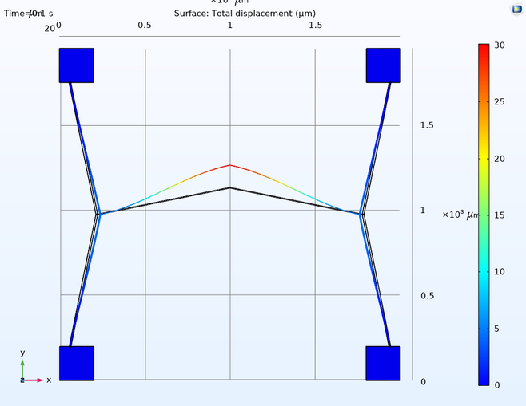
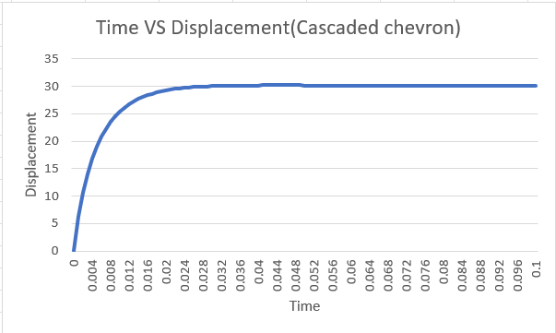
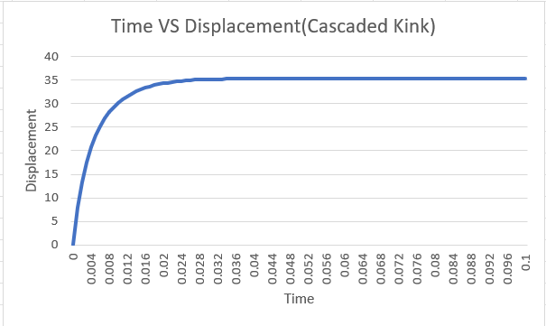
COMPARATIVE STUDY OF THE CASCADED CHEVRON AND THE CASCADED KINK ACTUATOR (HOW OUR STRUCTURE IS BETTER?)
DISPLACEMENT
Max. Displacement -30um
Max. Displacement -35um
Max. Displacement at-30ms
Max. Displacement at-26ms
Notes:
This result of the displacement has shown that two
structures of the same material and dimensions of beam
length, it has resulted in two very different result with a
difference of 5um i.e., 16% gain in the displacement. The
transient analysis shows that the Cascaded kink actuator
reaches its maximum displacement more than and faster
than cascaded chevron by 4ms

Slide 16
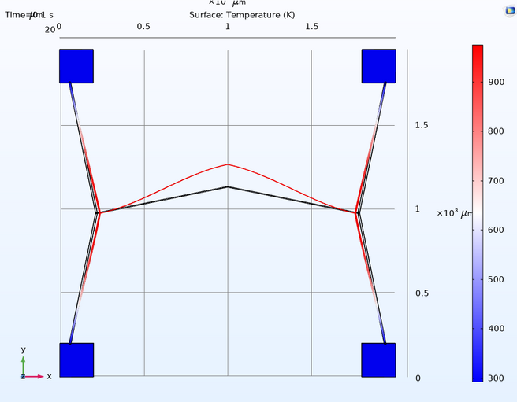
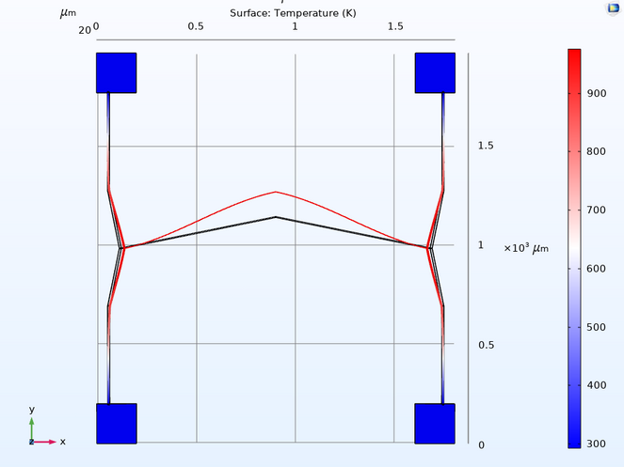
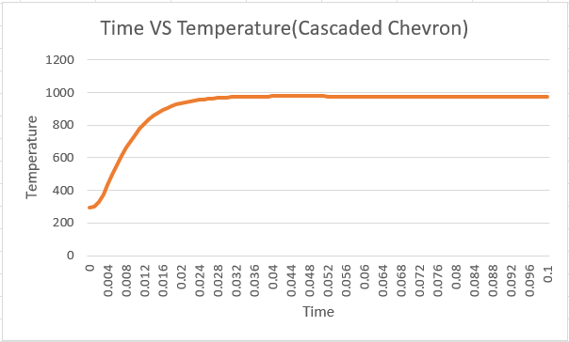
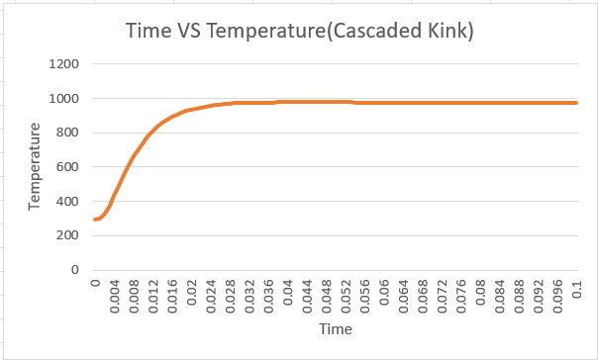
COMPARATIVE STUDY OF THE CASCADED CHEVRON AND THE CASCADED KINK ACTUATOR (HOW OUR STRUCTURE IS BETTER?)
TEMPERATURE
Notes:
the results for temperature have been same for both the
Cascaded Chevron actuator and Cascaded Kink actuator

Slide 17
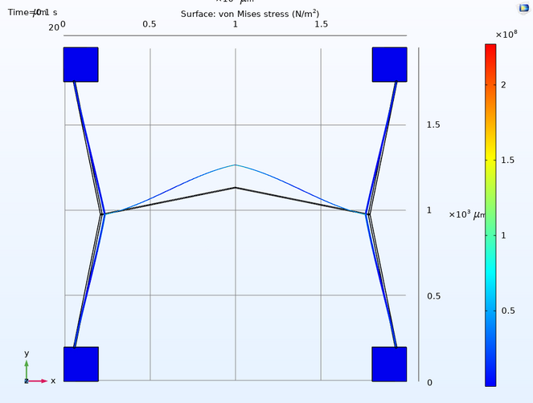
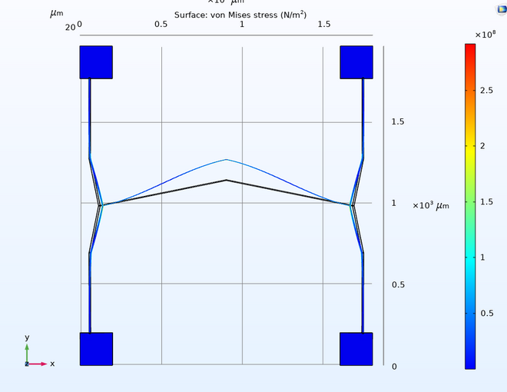
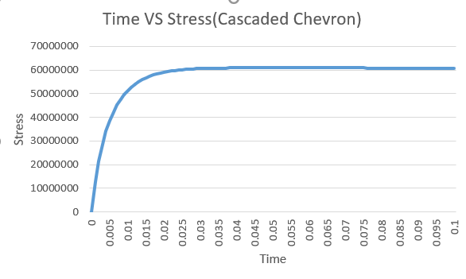
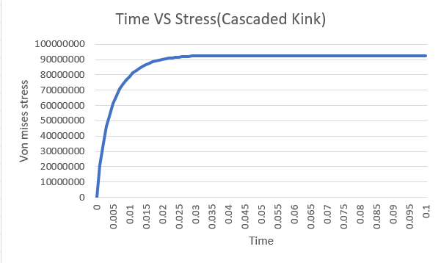
COMPARATIVE STUDY OF THE CASCADED CHEVRON AND THE CASCADED KINK ACTUATOR (HOW OUR STRUCTURE IS BETTER?)
STRESS
Notes:
The stress analysis plot shows that the stress for cascaded
kink actuator has a stress of 1x108 N/m2 more than that of
the cascaded chevron actuator, but well under the stress
constraint.

Slide 18
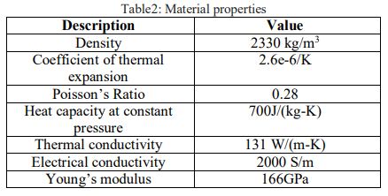
ELECTRO THERMAL ANALYSIS
As we fabricate using the SOI wafer configuration, the height of the beam equals the active layer thickness and the gap ‘g’ between the beams and the substrate equals the oxide layer thickness. In the case of very small gap under a suspended silicon beam, convention and radiation can be considered to be negligible and conduction through air to the substrate dominates. But, conduction from sides of the beam to the surrounding air to the substrate cannot be ignored and must be accounted for the shape conduction factor ‘S’. This geometric factor represents the heat loss from the sides and the bottom of the beam to expected heat loss from the bottom of the beam only.[5] An empirical equation has been developed for 2um to 50um. This shape factor is given by,
S=4/w(10^-6+g)+1
Heat loss due to air gap is given by
Q=SKaw dx dt/g
Notes:
In the proposed structure of the cascaded kink beam the
actuator beam lengths are found to be longer than the height
and widths. So in case of small gap under a suspended silicon beam we have to consider the conduction from the sides of the beam to the substrate accounting for the shape factor(a measurement of the direct exchange of heat energy between two surfaces) given by ---
heat loss due to air gap is given by---

Slide 19
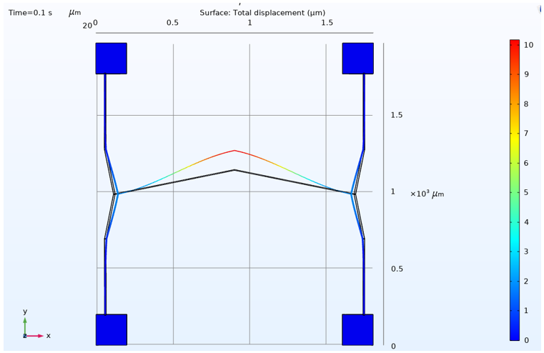
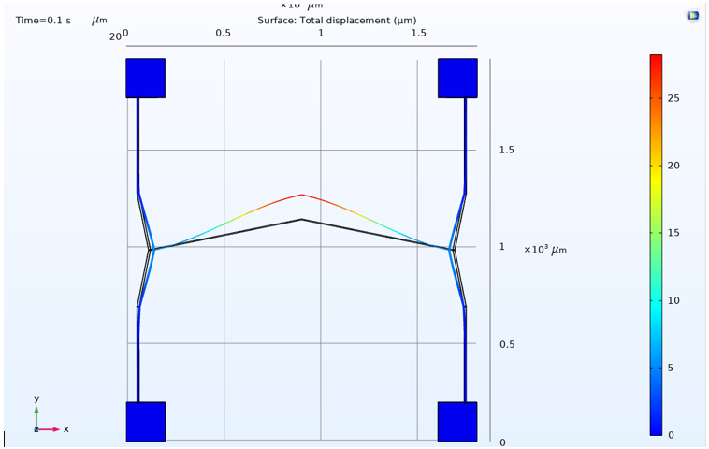
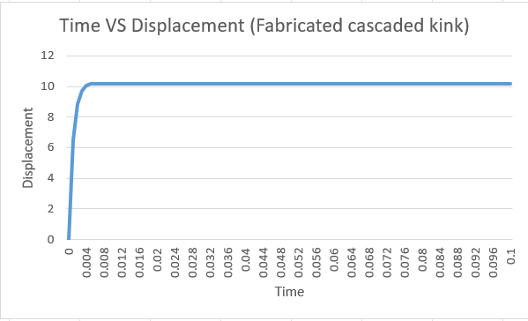
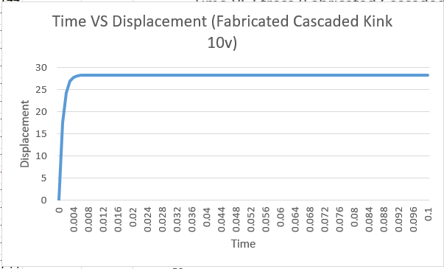
ELECTROTHERMAL ANALYSIS RESULTS
6 Volts
10 Volts
Notes:
in this cases we have considered the conductivity of air and simulated the results , of how the heat will be dissipated to the substrate.
{{{{{{{{{{{{{{{{anchor loses----
as we have considered the EBC (essential boundary condition) mode for our analysis and we have used the anchors as the heat sink we haven't quantified the anchor losses, and as it is on a substrate after fabrication, the anchor losses are very small and do not affect the result by a huge margin that will affect the system, also the size of the structure is very small as the beams are thinner.

Slide 20
Conclusion
For a voltage of 6v, we achieve a displacement of 35um and for a voltage of 10v, we observe a displacement of 95um.
The suitable model works best between a supply voltage of 1.5 v and 8.5 v producing a displacement greater than 2um.
Fully cascading the kink beam actuator results in failure of the system, which is why using the primary beams as the kink actuators and the secondary beam to be the bent beam for amplifications of displacement has better results.
Considering the transient analysis, when we compare the cascaded kink beam actuator and the cascaded chevron beam actuator, the cascaded kink beam actuator transcends the cascaded chevron beam actuator in two factors. One is the displacement and the other is the time taken to reach maximum displacement.

Slide 21
THANK YOU

